Slide 1

Creative Writing Project
2023

Slide 2
Creative Writing Project
No limits!
Students at colleges up and down the country are being invited to put pen to paper in a creative writing project. Selected work from participating colleges will be published in an anthology available for all to read
You can write in any format about anything that interests you. So you can write poetry or prose, fiction, or non-fiction, anything at all – there are no limits!
The blank page can be daunting, though. For that reason, we’ve put together some ideas about how to start off your writing. These are followed by some writing prompts that you can draw on or ignore, as you wish.

Slide 3
Details
The task: Produce a piece of creative writing in a form of your choice. You can draw on some of the prompts offered, or use your own ideas
Constraints: Limit of 500 words
Submission date: 5th May 2023, 16.00
Incentive: The most interesting pieces will be published in an anthology. This will be available for all to read online.
Long Road will submit 5 entries to the national project co-ordinators to be considered for inclusion in their online anthology
All submissions will be published in our Long Road Creative Writing emagazine.
You can choose to write in any form, about any topic. So you might choose to write a story, or a poem; or you might decide to write a personal piece, or a film script, or a speech. You can write a complete piece that falls within the limit, or the start of a longer piece up to the word limit.

Slide 4
What do I do?
Write something! You can use one of the prompts at the end of this presentation to get started, or just write something from your own ideas
You can write in any form: poetry, short story, fiction, non-fiction, script …
Make sure the file name contains YOUR NAME. If you share as a Onedrive or Google docs file, make sure your permissions allow other people to open it!
Send it to hregan@longroad.ac.uk to enter, along with your consent form by Friday 5th May
We can’t accept entries without a consent form as this is you giving us permission to share your work. The consent form also asks for permission to edit your work (this would generally be for spelling/grammar etc, or potentially adding a title/changing a word. We wouldn’t make substantial changes).
Don’t forget the word limit of 500 words. If you’ve written something longer, select a smaller section as your entry.

Slide 5






Writing prompts
Over the next five pages you’re going to be given different prompts to get you started on a piece of creative writing of your own.
Take photos of each page, so you can refer back to them and spend time thinking about what you will do.
Discuss your initial ideas in small groups. Which prompt might you use? What kind of writing do you want to produce? What are you going to write about?

Slide 6
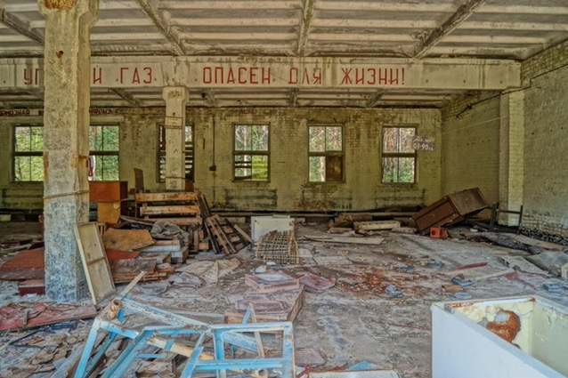

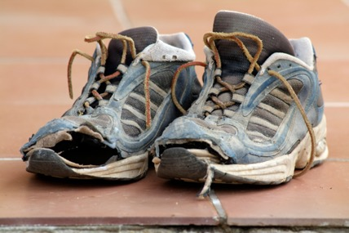

Slide 7
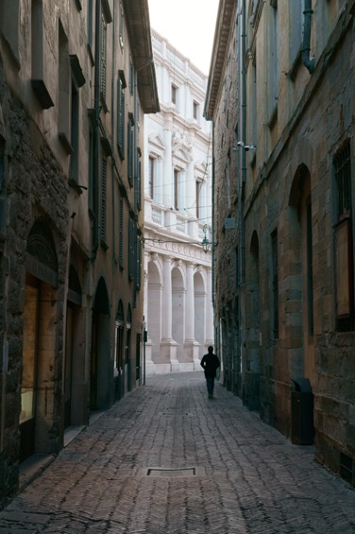
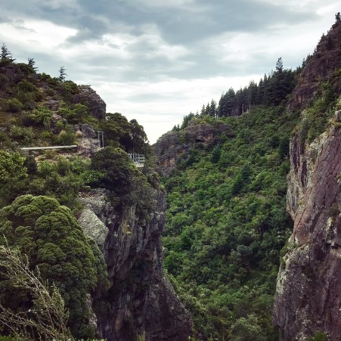


Slide 8
Poetry prompts
The lines below all come from poems. Use one or more as a prompt to get you started on a piece of writing of your own. You don’t have to stick to poetry.
Something seems to be missing from the heart | It is difficult to know what to do with so much happiness
His whole world lies on that bedroom floor | Sometimes you don’t die when you’re supposed to
The shadow coursed on | The darkest evening of the year
So come, by raft, by hovercraft | I lost two cities, lovely ones
You will be four minutes from home | Years later I smile to think of that journey

Slide 9
Word prompts
Use one or more of the words below as a prompt to get you started on a piece of writing of your own.
earbuds | bike | opportunity | water
dog | ring | glare | chase
villa | queue | noise | ravine
cap | sprinting | staircase | hunger
butterfly | worry | glasses | storm

Slide 10
Free write
In the spirit of no limits, feel free to ignore all of the prompts you’ve just been given and write something entirely from your own ideas.
If you do, you might still want to talk your ideas through with other people and sketch these out before you get going.

