Slide 1


How do I use
Supervised Rest Breaks?
Student Guide SRB

Slide 2
What are Supervised Rest Breaks?
Supervised Rest Breaks (or Rest Breaks) are a centre delegated Access Arrangement, that is to say that they are granted by the college in line with JCQ guidance.
The latter requires that ‘..the candidate has an impairment which has a substantial and long-term adverse effect, giving rise to persistent and significant difficulties. (The candidate is disabled within the meaning of the Equality Act)’. Furthermore, it must be ‘..his/her normal way of working within the centre’ and ‘..the candidate’s difficulties must be established within the centre..’
Student Guide SRB

Slide 3
What evidence do we need?
For the college to consider granting Rest Breaks for a long-term condition, evidence will usually be required that a student is receiving clinical care at a consultant level, and that he or she is requiring rest breaks on a day-to-day basis beyond those normally provided by morning break and lunchtime.
Your use of rest breaks will be recorded on you One Page Profile
Student Guide SRB

Slide 4
Who benefits from supervised rest breaks?
Supervised rest breaks provide a structured way for students to manage fatigue, stress, or medical conditions during exams while maintaining fairness and exam integrity.
They are carefully regulated, timed, and monitored, with the total break time pre-agreed and added to the exam duration.
Students must follow strict rules during breaks, including remaining under supervision and not accessing exam materials.
Student Guide SRB

Slide 5
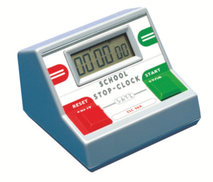
How does it work in practice?
Your Statement of Entry and One Page Profile informs you of the total amount of rest break time you could use per hour if needed for each exam. You do not need to use the whole time listed, e.g. you might have 10 mins/hour agreed, but only need a 5-minute break in the exam.
You should tell the invigilator when you need to take a rest break by raising your hand or telling the invigilator verbally that you need to take a break.
The invigilator will note the start of your rest break, and your break will then be timed. You may have a timer on your desk to turn on and off to time your rest break.
During breaks you will not be permitted to access either your question or answer papers. This will be monitored by the invigilator.
You must maintain full exam conditions i.e., not interact with other students during your rest breaks. You will not be allowed to leave the building during rest-breaks
You may stay in the exam room or may leave the room if supervised by a member of staff. This can include going to the toilet, or for a specific disability-related reason stated in your One Page Profile.
You must inform the invigilator when you are ready to return to your paper. The time taken will be added to your exam end time.
Student Guide SRB

