Slide 1

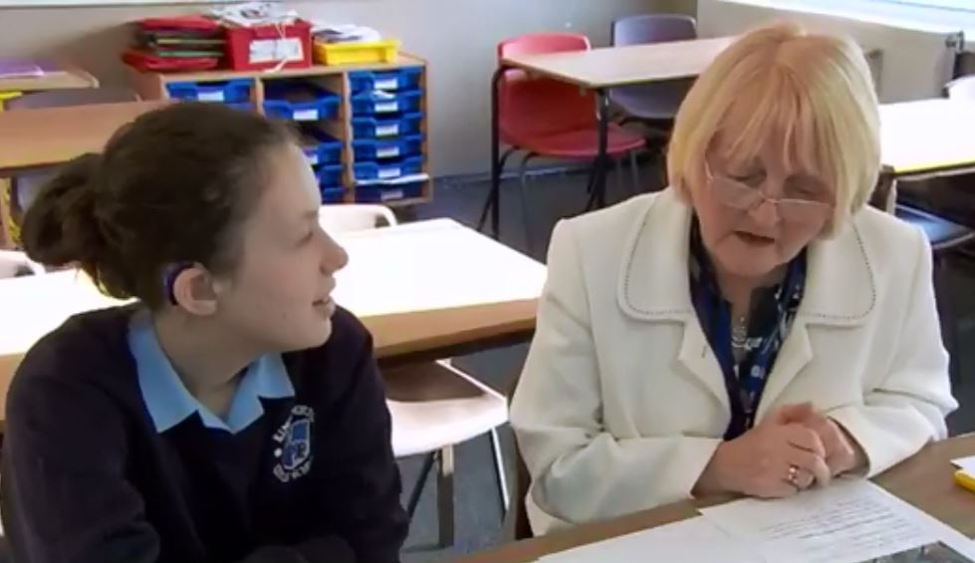
How do I use a Human Reader?
Student Guide HR

Slide 2

Why would I need a human reader?
Some students with reading difficulties will have problems accessing the examination paper and reading back their own work so will benefit from a human reader.
Students with visual or hearing impairment, dyslexia, or have Learning Disabilities might use a human reader.
If you use a human reader, then we would expect to see you asking your teacher or LSA to read text to you when you are in lessons or study support sessions.
Your use of a human reader will be recorded on you One Page Profile
Student Guide HR

Slide 3
What evidence do we need?
The Additional Learning Support Department (Academic Support) must produce a statement confirming the nature of your difficulties and outline how the use of a reader reflects your normal and current way of working within the centre.
They must be satisfied that there is a genuine need for a human reader due to poor reading skills.
Student Guide HR

Slide 4
Rules for a Human Reader
may help a vision-impaired candidate retrieve information found in diagrams, graphs, maps and tables so that they have access to the same visual information as a sighted candidate. The candidate must make clear what help they require;
may read numbers printed in figures as words (e.g. 356 would be read as three hundred and fifty-six, but when reading the number, it should also be pointed to on the question paper). An exception would be when the question is asking for a number to be written in words (e.g. write the number 356 in words);
may decode symbols and unit abbreviations in Maths and Science examinations for candidates who require this arrangement to access the assessment, reflecting their current and normal way of working within the centre;
may, if requested, give the spelling of a word which appears on the paper but, otherwise, spellings must not be given;
may read back, when requested, what the candidate has written without any emphasis on any errors;
must read accurately;
must have appropriate subject knowledge in order to act effectively as a reader
in Maths and Science examinations and to decode symbols and formulae with accuracy;
  must only read the instructions of the question paper and questions, and must not explain or clarify;
  must only repeat the instructions of the question paper or questions when a candidate indicates a specific need for help;
must only read the instructions/rubric of a paper testing reading, and must not read individual questions or text;
must abide by the regulations since failure to do so could lead to the disqualification of the candidate;
must not advise the candidate regarding which questions to do, when to move on to the next question nor the order in which questions should be answered;
must not decode any symbols in a Music examination
Student Guide HR

Slide 5
Candidate Information: Human Reader
The reader might be someone who will read just to you, or you might share a reader with other students, asking for help with reading when you need it.
You will be working in a room separate from the main hall.
You can ask the reader to:
  read all or part of the exam paper, as many times as you like
  read back any of your answers
The reader cannot:
  read any of the questions or passages to you in a paper (or sections of a paper) which is testing reading. For example, the reading papers in English and Modern Foreign Languages.
  explain or clarify any of the paper. They can only read word for word from the paper, and will only re-read if you ask them to
  read symbols (e.g. x or +) or unit abbreviations (e.g. cm or kg). The reader will point to these, but in most cases, they will not be able to read them out to you.
  help you to choose which questions to do
  tell you when to move on to the next question, or in what order to do the questions.
Student Guide HR

